Slide 1
Best Neighborhood in Pittsburgh

Slide 2
What Makes it the Best?
Our definition of the best neighborhood will be dictated by what neighborhood is the safest.
Data sets to be looked at:
Least amount of fire incidents
Least amount of arrests
Least amount of reported crimes

Slide 3
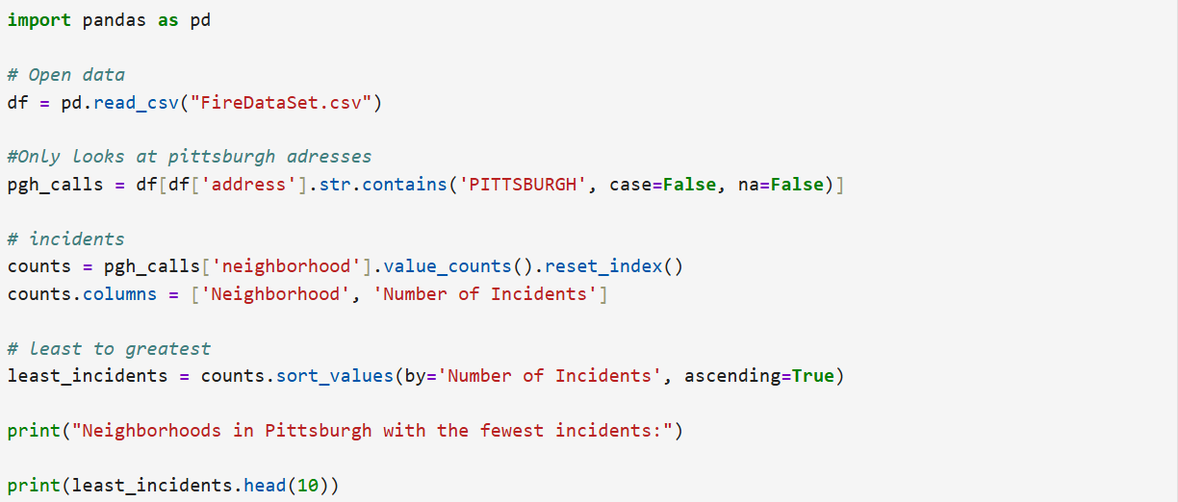

Slide 4
Fire Incidents
Incident count (Top 3)
Mount Oliver Borough: 7 Incidents
Regent Square: 7 Incidents
East Carnegie: 11 Incidents
Best Neighborhood Based on Fire Incidents
Mount Oliver Borough and Regent Square are equally safe
Other Data Sets will be more conclusive

Slide 5
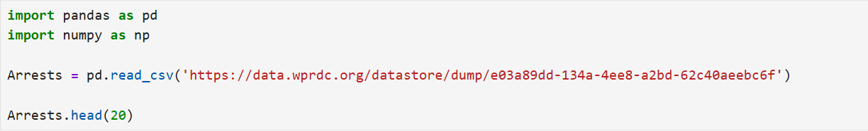
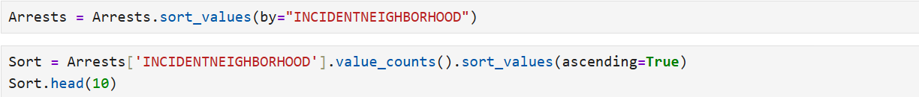

Slide 6
Quantity of Arrests
Arrest Count
Mt. Oliver Neighborhood: 2
Troy Hill-Herrs Island: 6
Mt. Oliver Borough: 18
Best Neighborhood based on arrest
Unlike the fire data set Mt Oliver Neighborhood is the safest neighborhood
Mt Oliver Borough still makes the top three safest

Slide 7


Slide 8
Crime Incidents
Incident Count (Top 3)
Mt. Oliver Boro: 101
Mt. Oliver Neighborhood: 117
Troy Hill-Herrs Island: 252
Best Neighborhood based on Crime Incidents
Looking at this data set shows that Mt Oliver Borough is still the safest neighborhood

Slide 9
Final Thoughts
The data leads to Mt Oliver Borough being the obvious best or safest neighborhood
Mt Oliver and Mt Oliver Borough are technically different entities
Mt Oliver Borough isn't technically Pittsburgh but its located in between Knoxville and Pittsburgh
It’s still important to know the safety of the Borough due to proximity of Pittsburgh
If disregarding the Borough the Neighborhood is the safest neighborhood

Slide 10
GitHub Repo
https://github.com/Gleason2044/Final-Project.git

